Slide 1
Modeling Combinational Logic Circuits
Debdeep Mukhopadhyay

Slide 2
Types
logical/ arithmetical equations
multiplexers
encoders
priority encoders
decoders
comparators
Arithmetic Logic Units (ALUs)

Slide 3
Useful Verilog Constructs
if
case
  casex: handles don’t cares also.
for: leads to compact coding.
always
assign

Slide 4
Use of parenthesis
module logic_struct(A1,B1,C1,D1,A2,B2,C2,D2,Y1,Y2);
input [7:0] A1,B1,C1,D1,A2,B2,C2,D2;
output [7:0] Y1,Y2;
reg [7:0] Y1,Y2;
always @(A1 or B1 or C1 or D1 or A2 or B2 or C2 or D2)
begin
Y1=A1+B1+C1+D1;
Y2=(A2+B2)+(C2+D2);
end
end
endmodule

Slide 5
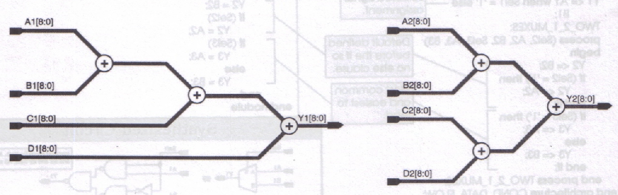
Synthesized Circuit Structure
Second circuit has a shorter critical delay (longest path delay)!

Slide 6
Modeling Multiplexers
Five ways of modeling multiplexers:
  one if statement with multiple else/else if clauses.
  nested if statements
  case statements

Slide 7
4-1 Mux: method 1
always @(sel or A or B or C or D)
begin
if(sel==2’b0)
Y=A;
else if(sel==2’b01)
Y=B;
else if(sel==2’b10)
Y=C;
else
Y=D;
if
else if
else

Slide 8
4-1 Mux: method 2
always @(sel or A or B or C or D)
if(sel[1]==0)
if(sel[0]==0)
Y=A; //sel=00
else
Y=B; //sel=01
else
if(sel[0]==0)
Y=C; //sel=10
else
Y=D; //sel=11
nested if, else statements

Slide 9
4-1 Mux: method 3
always @(sel or A or B or C or D)
case(sel)
2’b00: Y=A;
2’b01: Y=B;
2’b10: Y=C;
2’b11: Y=D;
default: Y=A;
endcase
More Compact and clear

Slide 10
A Comparison: Case is simulation efficient
Sparc/32Mb RAM, Solaris 2.5, Verilog XL | Data Structure (bytes of memory) | Memory Usage Percentages | Simulation Time (in seconds) | CPU Simulation
CaseMux8 | 92252 | 100.00% | 1209.3 | 100%
Ifmux8 | 92912 | 100.72% | 1282.0 | 106.01%

Slide 11
Encoders
Discrete quantities of digital data are often represented in a coded form.
Encoders do that.
A typical encoder takes in 2^{n} input lines and provides n encoded output lines.
Assume that only one of the inputs is 1 at any given time, otherwise the output is undefined and have some meaningless value.

Slide 12
8-3 encoder
A7 | A6 | A5 | A4 | A3 | A2 | A1 | A0
0 | 0 | 0 | 0 | 0 | 0 | 0 | 1
0 | 0 | 0 | 0 | 0 | 0 | 1 | 0
0 | 0 | 0 | 0 | 0 | 1 | 0 | 0
0 | 0 | 0 | 0 | 1 | 0 | 0 | 0
0 | 0 | 0 | 1 | 0 | 0 | 0 | 0
0 | 0 | 1 | 0 | 0 | 0 | 0 | 0
0 | 1 | 0 | 0 | 0 | 0 | 0 | 0
1 | 0 | 0 | 0 | 0 | 0 | 0 | 0
Y2 | Y1 | Y0
0 | 0 | 0
0 | 0 | 1
0 | 1 | 0
0 | 1 | 1
1 | 0 | 0
1 | 0 | 1
1 | 1 | 0
1 | 1 | 1

Slide 13
Verilog code
always @(A)
begin
if(A==8’b00000001) Y=0;
else if(A==8’b0000010)Y=1;
else if(A==8’b0000100)Y=2;
…
else if(A==8’b1000000)Y=7;
else Y=3’bx;
end
Why is this
line kept?

Slide 14
Verilog code
always @(A)
begin
if(A==8’b00000001) Y=0;
else if(A==8’b0000010)Y=1;
else if(A==8’b0000100)Y=2;
…
else if(A==8’b1000000)Y=7;
else Y=3’bx;
end
Minimizes the synthesize circuit.
The synthesizer may take for the 256-8
input cases
specified, the output as 0 or 1 as per
required, to generate a small circuit.

Slide 15
Using casex
always @(A)
begin
casex(A)
8’b 00000001: Y=0;
8’b 00000010: Y=1;
8’b 00000100: Y=2;
…
8’b 10000000: Y=7;
default: Y=3’bx;
endcase
end

Slide 16
Using for loop
always @(A)
begin
Test=8’b00000001;
Y=3’bx;
for(N=0;N<8;N=N+1)
begin
if(A==Test)
Y=N;
Test=Test<<1;
end
end
Compact and does not
grow with dimensions!

Slide 17
Priority Encoders
Operation of Priority encoder is such that if two or more single bit inputs are at logic 1, then the input with highest priority will take precedence.
How to code in verilog?

Slide 18
Model 1
always@(A)
begin
Valid=1;
if(A[7]) Y=7;
else if(A[6]) Y=6;
else if(A[5]) Y=5;
…
else if(A[0]) Y=0;
else
begin
Valid=0
Y=3’bx;
end
end

Slide 19
Model 2
always@(A)
begin
Valid=1;
casex(A)
8’b1xxxxxxx: Y=7;
8’b01xxxxxx: Y=6;
…
8’b00000001: Y=0;
default: begin
Valid=0;
Y=3’bx;
end
endcase
end

Slide 20
Model 3
always @(A)
begin
Valid=0;
Y=3’bx;
for(N=0;N<8;N=N+1)
if(A[N])
begin
Valid=1;
Y=N;
end
end

Slide 21
Decoders
Decode data that has been previously encoded using possibly binary format.
Automatic priority encoding with if and case, and “don’t care” output values are not needed.
The codes are left as an exercise.

Slide 22
Assignment 1
Problem 1: Write a verilog code for a four bit address decoder. It provides enable signals for segments of memory, the address map of which is shown below.
12-15
8-11
7
6
5
4
0-3

Slide 23
Assignment1
Problem 2:
Design a generic n-bit input, m-bit output binary decoder, with a separate enable input.
Instantiate the written module from another module, to realize a (2,4) and (3,6) decoder.

Slide 24
Assignment1
Problem 3: Compare the if else, nested if, case and for coding styles for modeling of various combinational blocks in terms of simulation time, cpu utilization and memory utilization of the processor. You can add any other interesting metric of your choice.

